Slide 1
Ch7
Artificial neural network
Shallow and Deep neural network
Training Neural Network Model
12191682 진태균

Slide 2
Contents
Artificial Neural Network
One-hot Encoding
Activation Function
Optimizer
Dropout

Slide 3
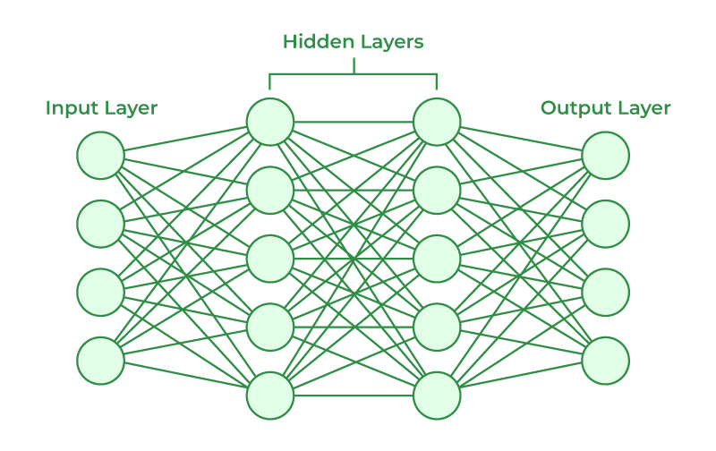
Artificial Neural Network
A subset of machine learning and the heart of deep learning algorithms

Slide 4
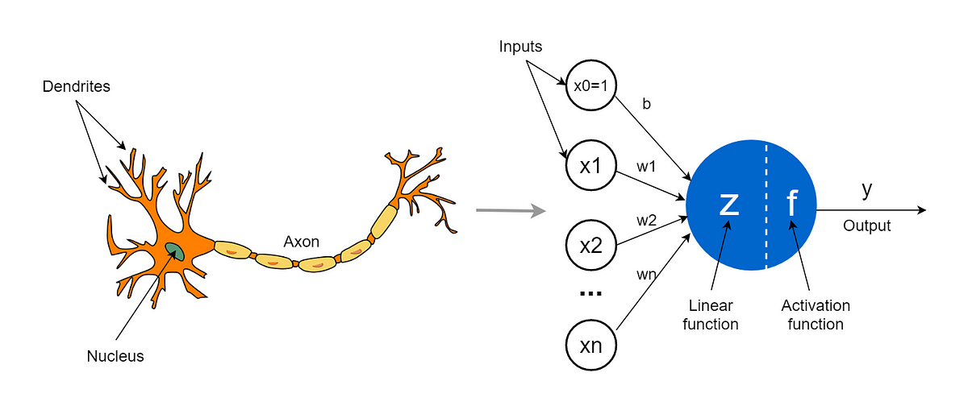
Artificial Neural Network

Slide 5
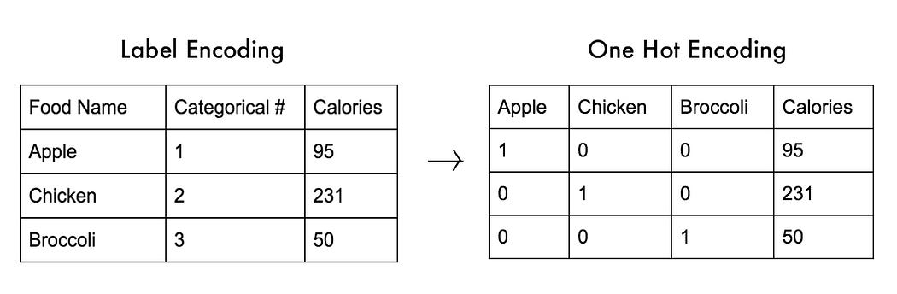
One-hot Encoding

Slide 6
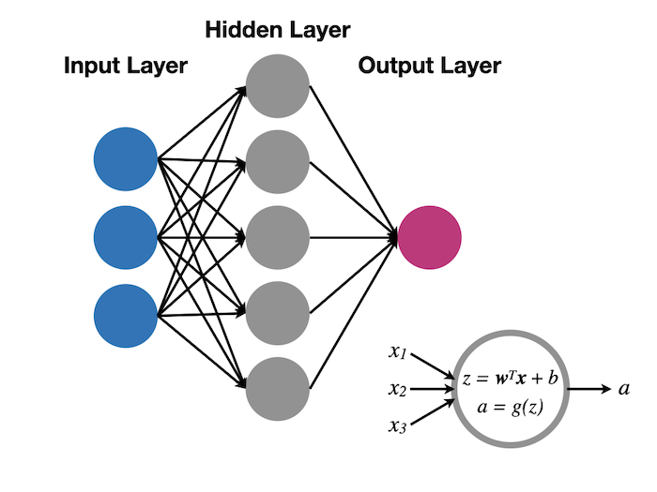
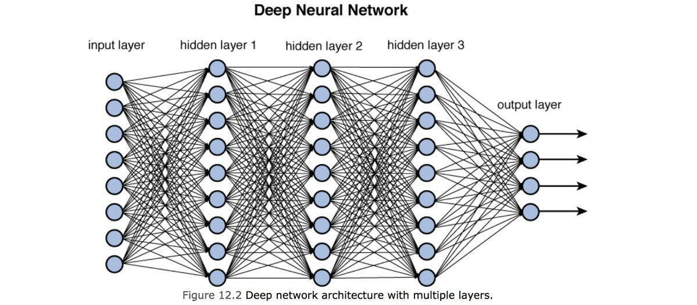
Shallow and Deep Neural Network
Shallow Neural Network
Deep Neural Network

Slide 7
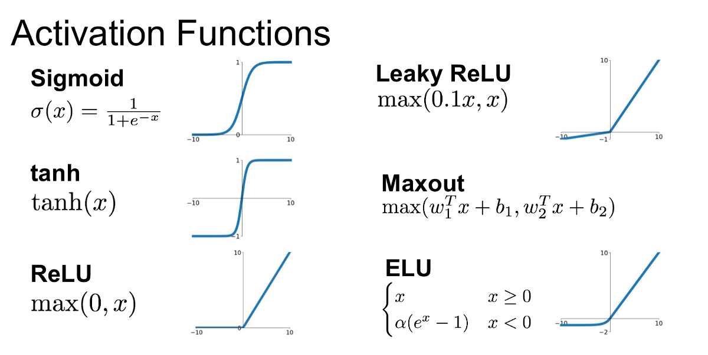
Activation Function
The activation function decides whether a neuron should be activated or not
by calculating the weighted sum and further adding bias to it.
2. The purpose of the activation function is to introduce non-linearity into the output of a neuron.

Slide 8
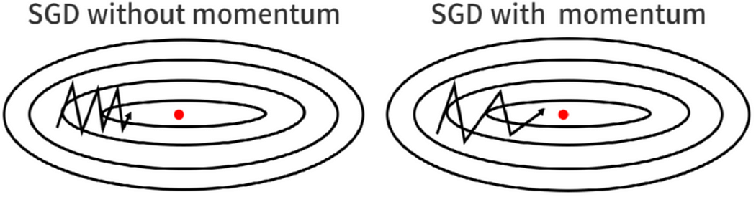
Optimizer
Optimizers are algorithms or methods used to minimize an error function(loss function)
or to maximize the efficiency of production.
Gradient Descent
Stochastic Gradient Descent
Mini-Batch Gradient Descent
SGD with Momentum

Slide 9
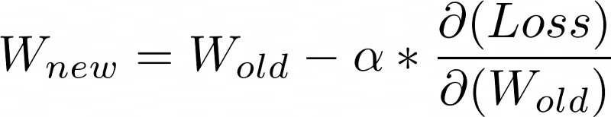
Optimizer
Optimizers are algorithms or methods used to minimize an error function(loss function)
or to maximize the efficiency of production.
Gradient Descent
Stochastic Gradient Descent
Mini-Batch Gradient Descent
SGD with Momentum

Slide 10
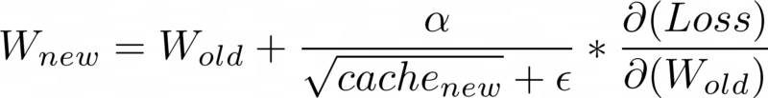

Optimizer
AdaGrad (Adaptive Gradient Descent)
RMS-Prop (Root Mean Square Propagation)

Slide 11
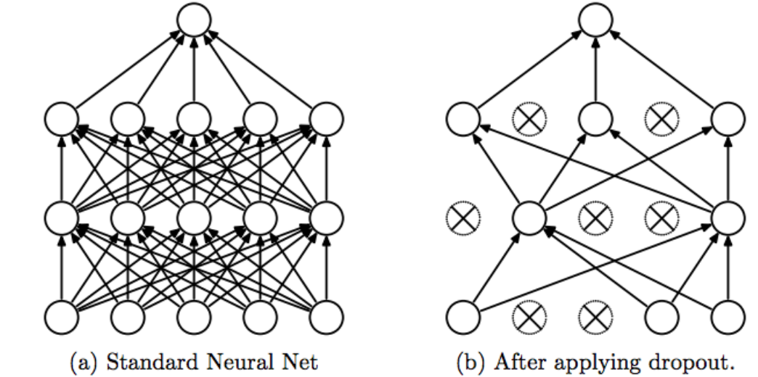
Dropout
for addressing overfitting

